Slide 1


Slide 2
The Use of Theory
Chapter 3

Slide 3
Introduction
What theories might be used?
Quantitative researchers test hypotheses from theory
Qualitative researchers may use as a lens or generate a theory
Mixed methods researchers may do both

Slide 4
Quantitative Theory Use
Testing causal claims in quantitative research:
Causality – expect variable X to cause variable Y
Confounding variables are third variables that may actually be the cause
True experiments test causal claims
Correlation analysis and surveys test hypothesized associations

Slide 5
Quantitative Theory Use
Variables in quantitative research:
Variable – characteristic of an individual or group that can be measured or observed
Examples: age, gender, socioeconomic status, attitudes
Variables may have temporal order or be measurable or observable

Slide 6
Quantitative Theory Use
Variables in quantitative research:
Independent
  Variables that probably cause outcomes
Dependent
  The outcomes that depend on the independent variables

Slide 7
Quantitative Theory Use
Variables in quantitative research:
Predictor
  Used to predict outcome of interest in survey method studies
Outcome
  Result or outcome of interest in survey method studies
  Share properties with dependent variables

Slide 8
Quantitative Theory Use
Variables in quantitative research:
Intervening or mediating
  Variables that stand between the independent and dependent variables
  Transmit the effects
Moderating
  Predictor variables that affect the relationship between independent and predictor variables
Control
  Variables that are measured and statistically "controlled"

Slide 9
Quantitative Theory Use
Definition of a theory in quantitative research:
Theory is a scientific prediction or explanation of what the Researcher expects to find
Interrelated set of constructs or variables
Hypothesis: predictive statement that is tested
Theory emerges from testing hypotheses over and over

Slide 10
Quantitative Theory Use
Definition of a theory in quantitative research:
Micro-level theories – limited to a small segment of time, place or number of people
Meso-level theories – link micro-level and macro-level theories
Macro-level theories – explain larger scales, for example the entire society

Slide 11
Quantitative Theory Use
Forms of theories in quantitative research:
Stated in
  Set of hypotheses – These are interconnected and demonstrate a process
  Series of if-then statements – These explain why one would expect an independent variable to influence or cause a dependent variable
  Visual model – These allow the reader to visualize the interconnections between the variables

Slide 12
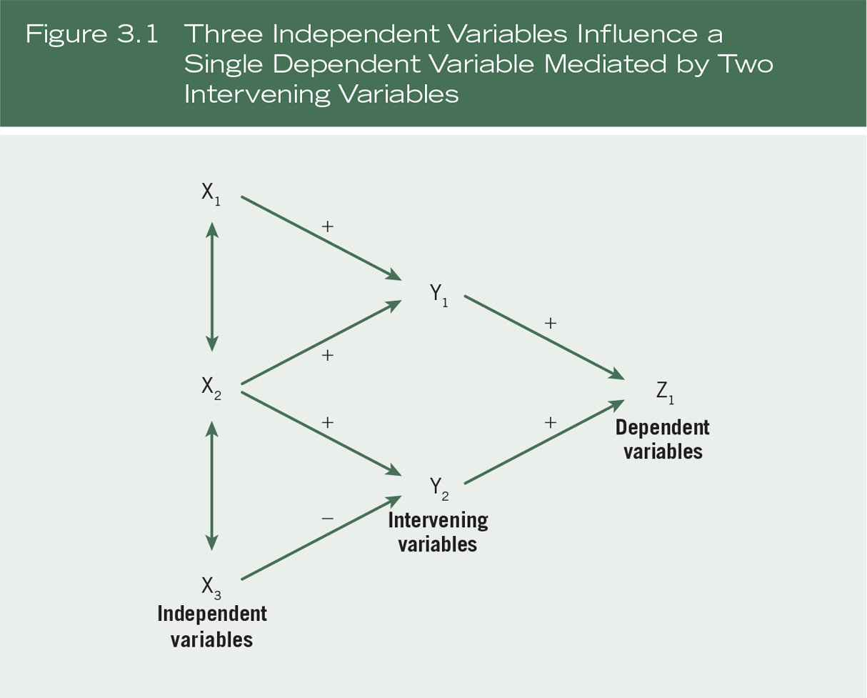
Quantitative Theory Use

Slide 13
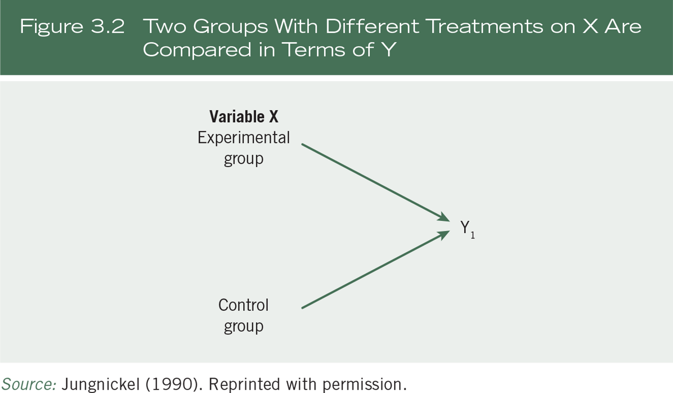
Quantitative Theory Use

Slide 14
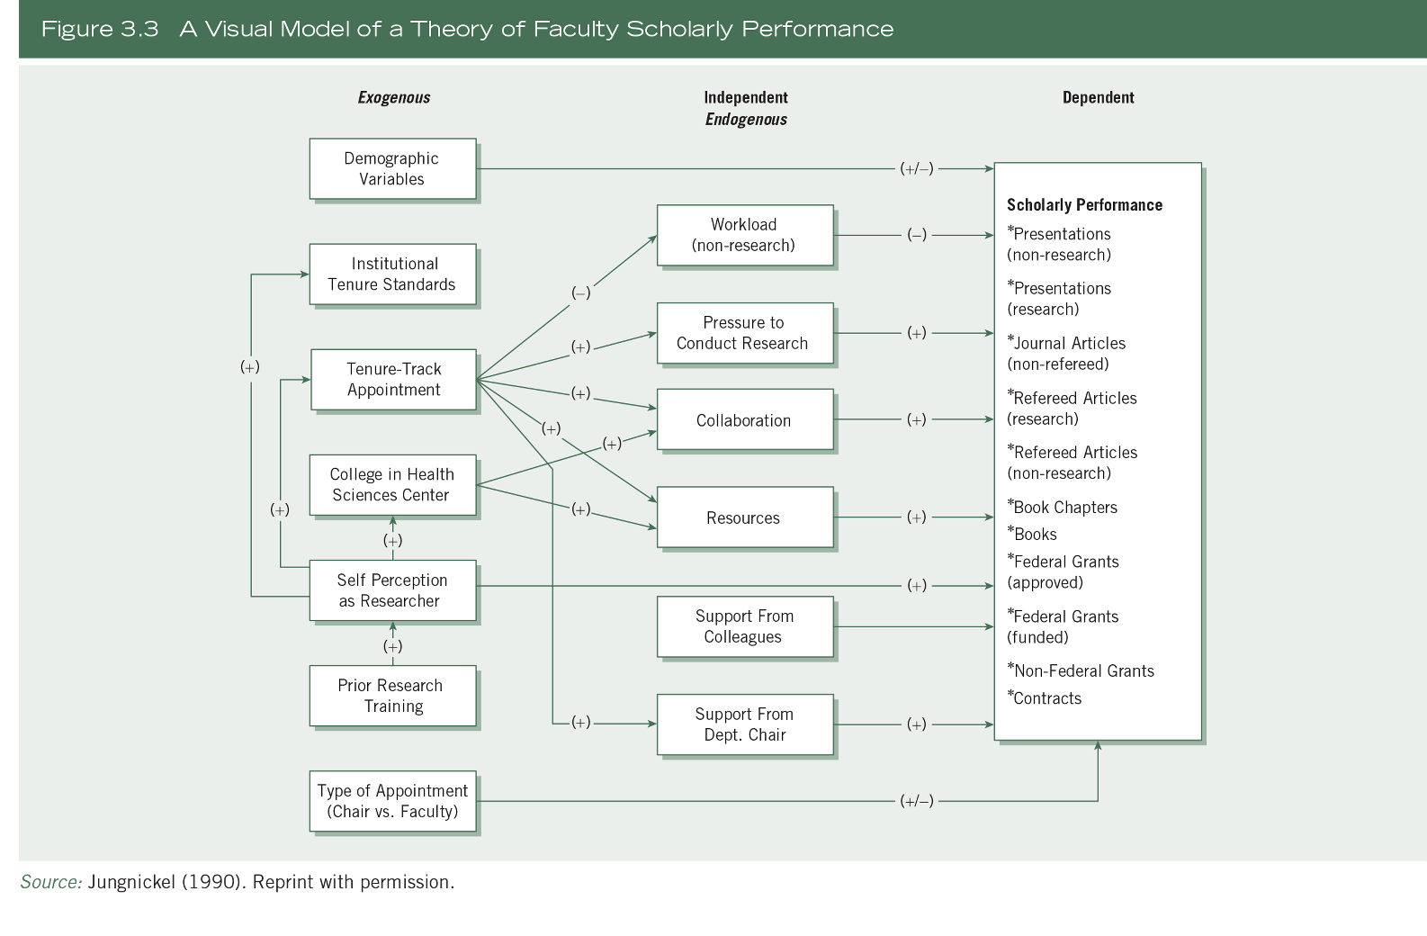
Quantitative Theory Use

Slide 15
Quantitative Theory Use
Placement of quantitative theories:
Towards the beginning of the study
Used deductively
Framework for study
Organizing model for
  Research questions or hypotheses
  Data collection procedure

Slide 16
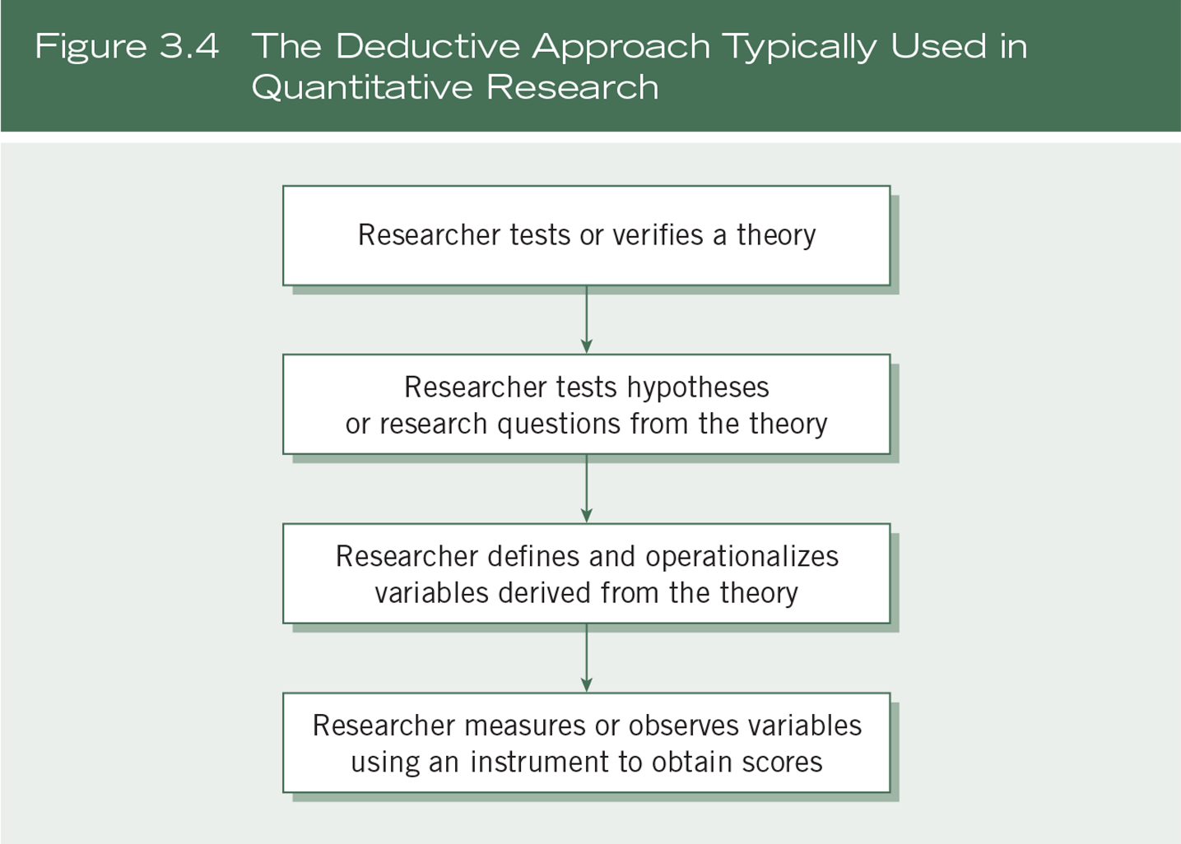
Quantitative Theory Use

Slide 17
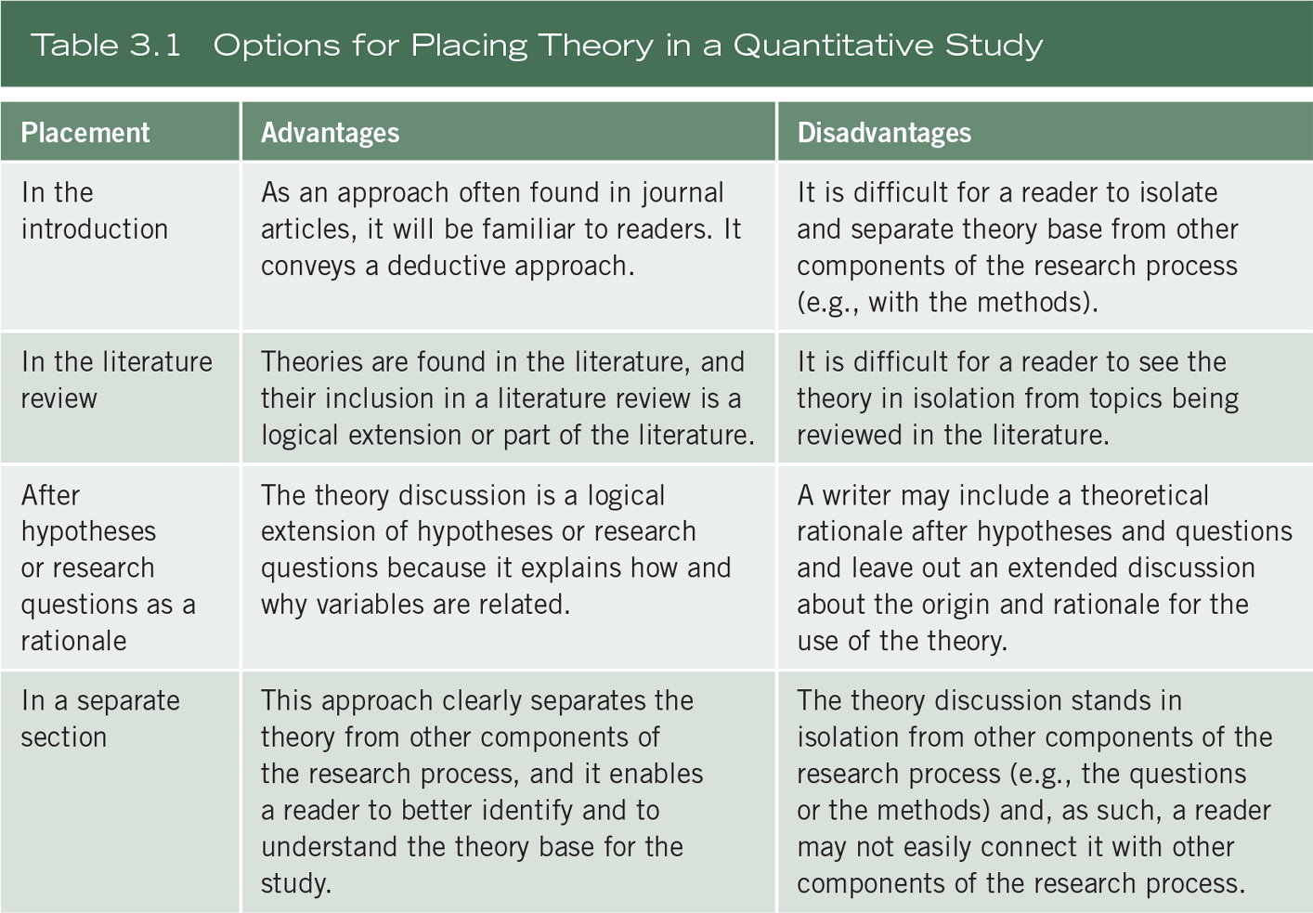
Quantitative Theory Use

Slide 18
Quantitative Theory Use
Writing a quantitative theoretical perspective:
Examine discipline specific literature (psychological, sociological, etc.)
Examine prior studies on the topic and related topics
Ask the question that bridges independent and the dependent variables
Script out the theory section (Example 3.1)

Slide 19
Quantitative Theory Use
Writing a quantitative theoretical perspective:
Script for the theory section
  Name the theory
  Identify origin, source
  Identify topics where it is applied
  Identify propositions or hypotheses
  State independent variables
  State dependent variables
  Provide a rationale

Slide 20
Quantitative Theory Use
Variation in theory use in qualitative research:
Used for a broad explanation
Used a theoretical lens or perspective – overall orienting lens for question of gender, class, and race
Theory becomes the end point in an inductive approach (Figure 3.5)
Do not employ any explicit theory

Slide 21
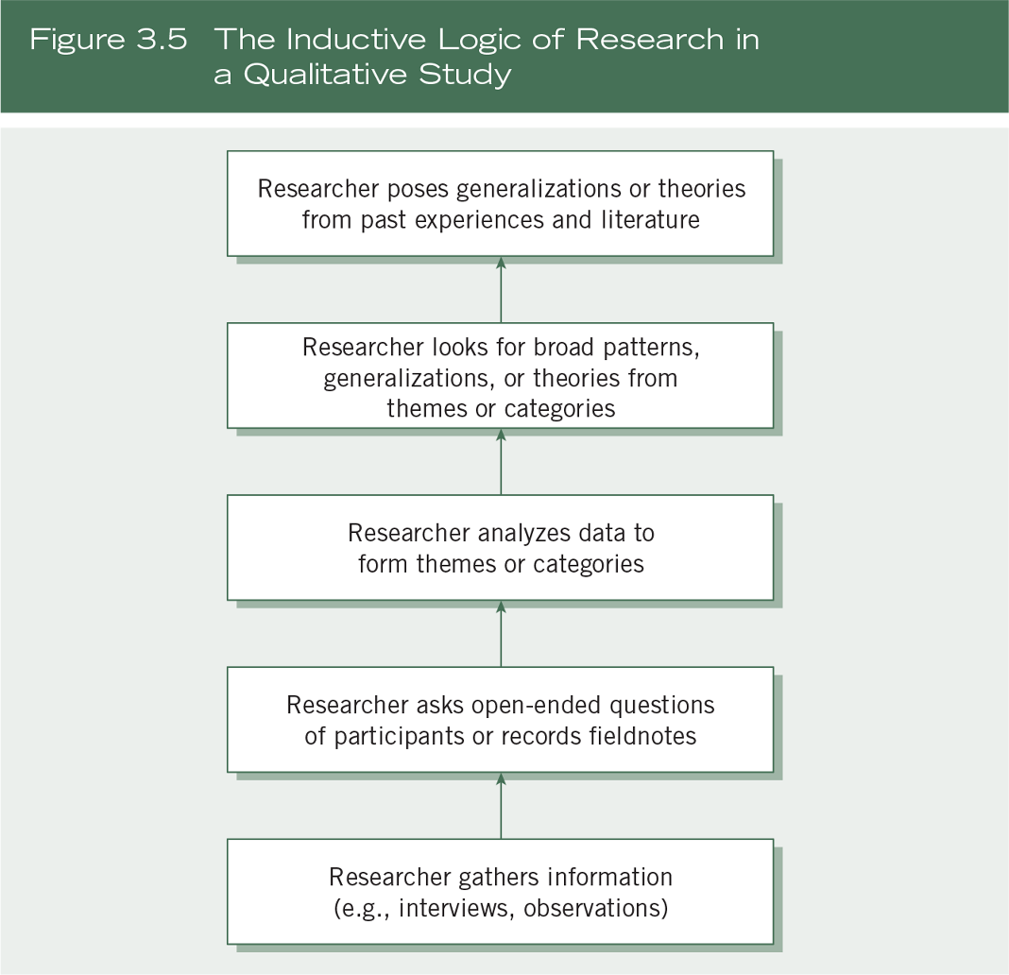
Quantitative Theory Use

Slide 22
Quantitative Theory Use
Variation in theory use in qualitative research:
Qualitative theoretical perspectives
  Feminist perspective
  Racialized discourse
  Critical theory
  Queer theory
  Disability inquiry

Slide 23
Quantitative Theory Use
Variation in theory use in qualitative research:
Decide if you will use a theory in your qualitative proposal
If used, identify how theory will be used
Locate theory early in the research proposal or at the end

Slide 24
Quantitative Theory Use
Locating the theory in qualitative research:
Studies with cultural themes or theoretical lens
  In the opening passages
Studies with an emerging design of qualitative inquiry
  At the beginning, may be modified
Studies based on grounded theory
  Theory derived inductively
  Placed at the end

Slide 25
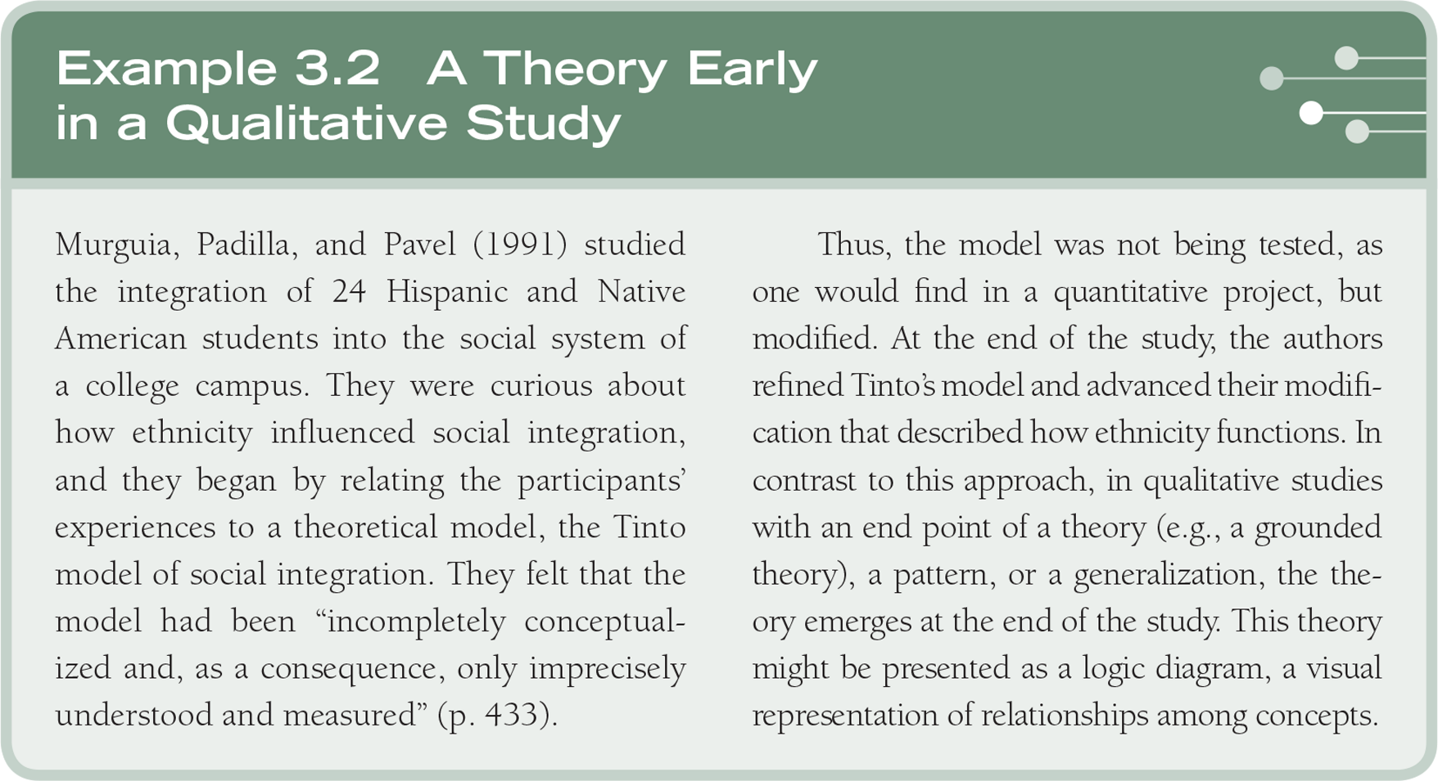
Quantitative Theory Use

Slide 26
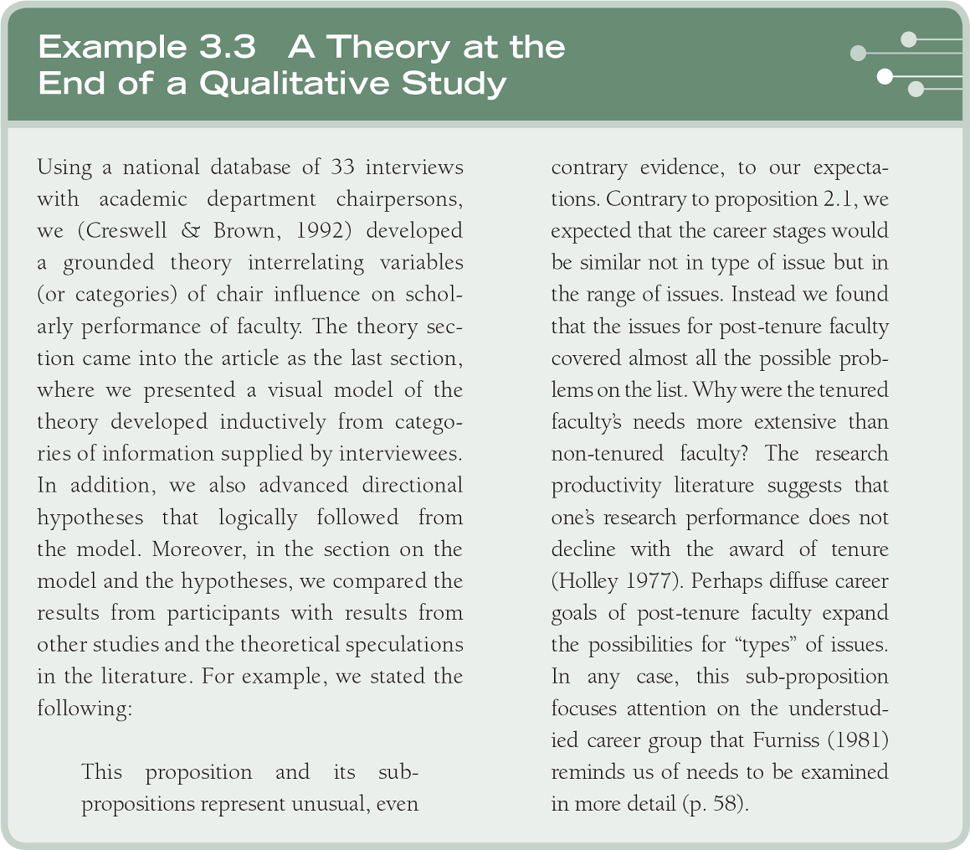
Quantitative Theory Use

Slide 27
Mixed Methods Theory Use
Mixed methods studies may:
  Include theory deductively (theory testing and validity)
  Include theory inductively (an emerging theory or pattern)
  Use a social science or participatory-social justice framework

Slide 28
Mixed Methods Theory Use
Social science theory use:
Placed at the beginning as an a priori framework to guides questions/hypothesis
Named and described, used to inform the explanation of the major variables in the study
Diagrammed to indicate the causal links
Used to guide the data collection process
Returned to at the end to inform findings and results

Slide 29
Mixed Methods Theory Use
Participatory-social justice theory use:
Growing use of transformative theory and mixed methods
Theoretical framework to inform a mixed methods project
Ethical stance of inclusion and challenging oppression
Designed to build trust
Use of results to enhance social justice

Slide 30
Mixed Methods Theory Use
Participatory-social justice theory use:
Incorporating into a mixed methods study
  Indicate at the beginning that transformative theory is in use
  Early in the study, outline the framework.
  Connect the theory with the existing body of knowledge on the topic
  Involve the community of interest in the process of the research

Slide 31
Mixed Methods Theory Use
Participatory-social justice theory use:
Incorporating into a mixed methods study
  Take a stand with the research question
  Advance in the design qualitative and quantitative methods
  Talk about your experience as a researcher
  End the study by advocating for change

Slide 32
Summary
Theory is used to:
Provide an explanation or prediction about the relationship among variables in quantitative research
Provide broad explanation, a theoretical lens, or as an end-point in qualitative research
Inform the design, data collection, analysis, and interpretation in mixed methods research

